Slide 1

NUTRITION AS PREVENTION
Diet and cardiovascular disease IN THE EU
Marleen Kestens, manager CVD prevention policies
4 February 2025

Slide 2

About EHN
The European Heart Network (EHN) is a Brussels-based alliance of over 30 heart foundations and associations dedicated to preventing cardiovascular diseases (CVD), representing patient interests and funding research throughout Europe.

Slide 3
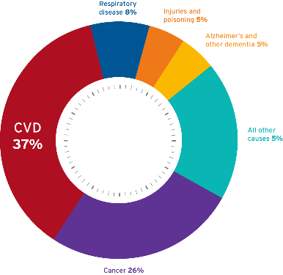
The burden of CVD
CVD is EU’s biggest killer
1,7 million deaths per/year
+ 13 million new CVD cases diagnosed annually
All other causes: 19%
+ 60 million people live with CVD
Premature death (before 65) :
17% for women, 24% for men
80% of CVD can be prevented

Slide 4
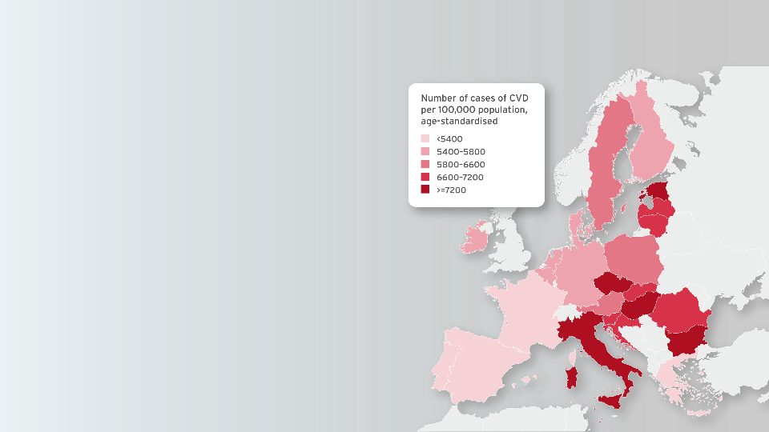
Inequalities from CVD across the EU
CVD mortality rates vary across EU
  20% at its lowest to 65% at its highest
Population disparities within countries
  Age, gender, ethnicity, socioeconomic status and region
Improving CV health is a fight for equality

Slide 5
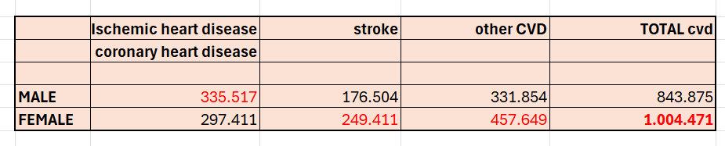
Inequalities from CVD across the EU
40% of all deaths in women are CVD
Mortality following heart attack is 20% greater in women vs men
Women are underrepresented in research

Slide 6
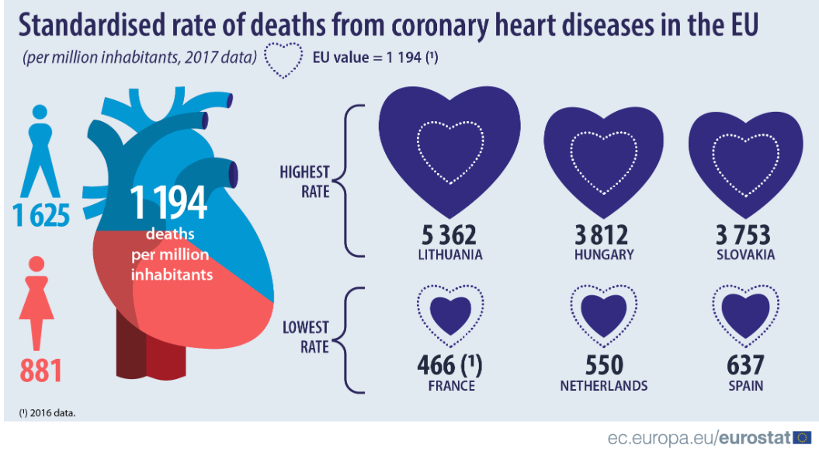
Inequalities from CVD across the EU
A woman in Lithuania is
13 times more
likely
to die from coronary heart disease than a woman in France

Slide 7
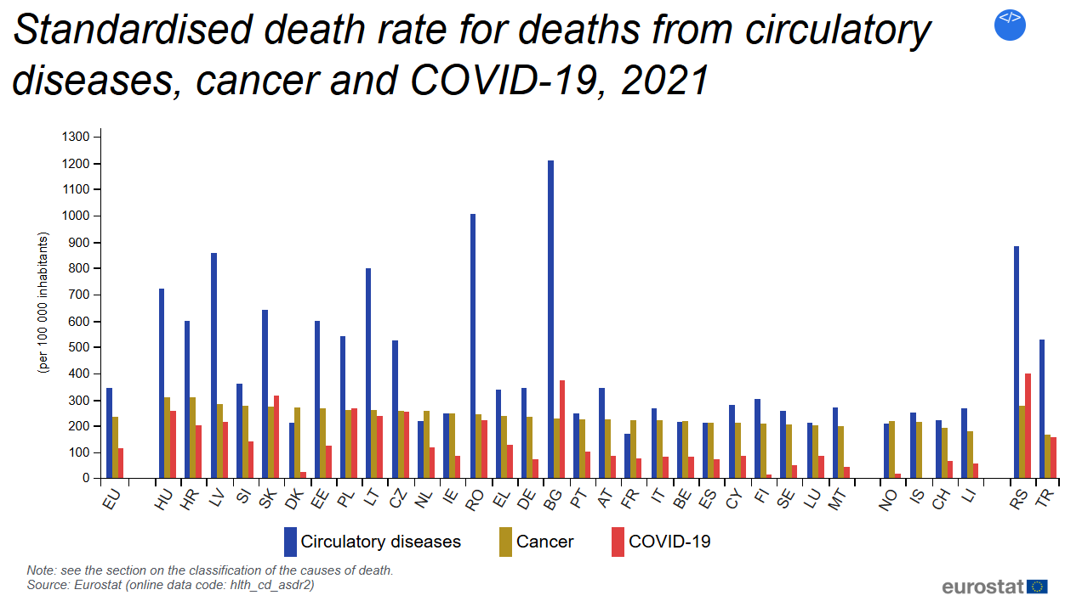
Inequalities in the EU: East – West divide

Slide 8
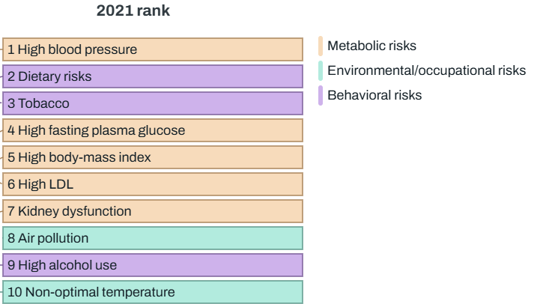
Causes of death in the EU
All non-communicable diseases combined
Source : global burden of disease

Slide 9
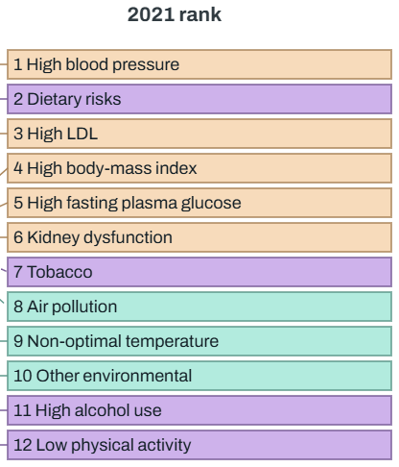
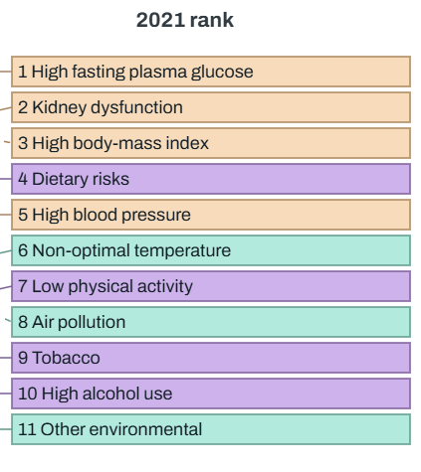
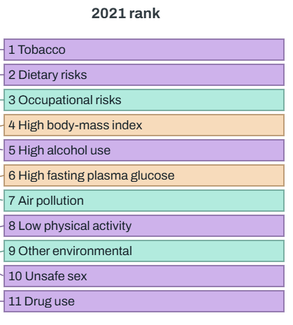
Causes of death in the EU
Cardiovascular Cancer Diabetes/kidney
Diet : 27% of all CVD Diet : 8% of all cancer Diet: 28% of all diabetes
(high blood pressure: 50%)
Source : global burden of disease

Slide 10
The need to keep people healthy
80 % of CVD can be prevented; 40% of cancer can be prevented
Many people are ill before they reach retirement age
Reduced exposure to risk factors increases the number of years lived in good health
Unhealthy diet
Tobacco
Physical inactivity
Alcohol consumption
Air pollution

Slide 11
Transform food and drinks policies
Poor diet is the leading contributor to ill health/disease and early death
Dietary risks account for over half of deaths in men and 40% of deaths in women
Dietary risk are responsible for more than 50% of years lost to CVD death or disability
Of all the risk factors that contribute to CVD, dietary factors are by far the largest contributors

Slide 12
Transform food and drinks policies
High sodium (i.e. salt) is the dietary risk with the largest impact on health, mainly due to its contribution to cardiovascular diseases like ischemic heart disease and hypertensive heart disease
Low consumption of healthy foods like fruits, vegetables, and whole grains puts populations at higher risk of cardiovascular disease.
Population based interventions are needed because they provide both human and economic benefits with considerable return on investment

Slide 13
Which changes are needed?
The need to shift to more plant based diets
A cardiovascular health promoting diet means a shift from the current animal based diet to a more plant based diet.
Fruit, vegetable and berry consumption needs to increase
Wholegrain consumption needs to increase
(Red) meat consumption and foods or drinks with low content of vitamins, minerals and dietary fibre needs to decrease
Rethink land use: using land for animal feed and then feed animals to humans? Not sustainable
Ensure trade and investment policies protect and promote public health

Slide 14
Which changes are needed?
Make the healthy choice the default choice : Offer foods that contribute to peoples health
Subsidise products that we need to consume more (tax products we need to consume less)
Address commercial determinants of health
Develop mandatory, easy to understand, colour-coded front-of-pack nutrition labelling
Include health criteria in public procurement rules for foods and drinks offered in public places such as schools, hospitals, public institutions

Slide 15
Which changes are needed?
Address food composition
Support reformulation programmes so that foods contain
Less salt
Less fat
Less sugar
More fibre
National dietary guidelines need to include sustainability aspects (see e.g. Denmark, Sweden)

Slide 16
Thank you!
EHN’s mission is to play a leading role, on behalf of people and patients in Europe, in promoting cardiovascular health and preventing and reducing cardiovascular disease, in particular heart disease and stroke, to ensure CVD is no longer a major cause of premature death and disability throughout Europe.
mkestens@ehnheart.org

